Slide 1

Naïve Approach Algorithm

Slide 2

What is Naïve Approach
Naïve Approach algorithms are distinguished by approaching the solution of a problem in the most natural obvious, simple, or direct method in contrast to a more clever or sophisticated way. Exhaustive enumeration is an example of a Naïve Approach algorithm. It describes a primitive programming style, one in which the programmer relies on the computer's processing power instead of using corresponding Algorithms to simplify the problem, often ignoring problems of scale and applying naive methods suited to small problems directly to large ones. The term can also be used in reference to programming style: Naïve Approach programs are written in a heavy handed, tedious way, full of repetition.

Slide 3
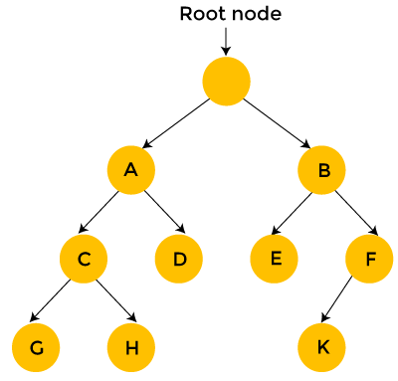
Visual representation
Indeed, Naïve Approach search can be viewed as the simplistic. It should not be confused with backtracking, where large sets of solutions can be discarded. The Naïve Approach solution is simply to calculate the total distance for every possible route and then select the shortest one. This is not particularly efficient because it is possible to eliminate many possible routes through clever algorithms.

Slide 4

Efficiency
Algorithms are most commonly judged by their efficiency and the amount of computing resources they require to complete their task.
A common way to evaluate an algorithm is to look at its time complexity. This shows how the running time of the algorithm grows as the input size grows. Since the algorithms today have to operate on large data inputs, it is essential for our algorithms to have a reasonably fast running time.
One of the ways in which you can speed up a the Naïve Approach algorithm is by reducing the search space (reducing the set of candidate solution) by making use of heuristics that are specific to the problem class.

Slide 5

What are the advantages of the Naïve Approach?
This algorithm finds all the possible solutions, and it also guarantees that it finds the correct solution to a problem.
This type of algorithm is applicable to a wide range of domains.
It is mainly used for solving simpler and small problems.
It can be considered a comparison benchmark to solve a simple problem and does not require any particular domain knowledge.
It is easier and simpler to implement than other algorithms

Slide 6

What are the disadvantages of the Naïve Approach?
These algorithms are neither constructive nor creative in comparison to algorithms that are constructed through the use of some other design paradigms.
This method relies more on compromising the power of a computer system for solving a problem than a good algorithm design.
Finding the right solution by this method consumes a lot of time. These algorithms run rather slowly.
The Naïve Approach is inefficient. For real-time problems.
It is very inefficient to use for big problems requiring solutions as it will take a considerable amount of time to compute.

